Slide 1
Exploring the Influence of Transaction Amounts on Fraudulent Activities in Credit Card Transactions
Author:
Chandrika Bhargavi Achanta
(M15399587)

Slide 2
Agenda:
Abstract
Introduction
Research Questions
Literature Review
Methodology
Discussion
Source Code
Results
Conclusion

Slide 3
Abstract
In the realm of financial transactions, particularly in credit card systems, the occurrence of fraudulent activities poses a significant challenge. Understanding the patterns and influences behind these fraudulent transactions is crucial for developing effective prevention and detection mechanisms.
One key aspect that warrants investigation is the relationship between transaction amounts and the fraudulent behavior. This exploration delves into how varying transaction amounts correlates with instances of fraudulent activities in credit card transactions.
The study explores the transaction amounts impact on credit card fraud likelihood, using the Credit card Fraud Detection Dataset. Initial analysis suggests limited correlation, but deeper examination reveals distinct trends, with machine learning models proving effective in fraud detection.

Slide 4
Introduction
Credit card fraud is a pervasive issue globally, posing significant threats to individuals and financial institutions alike.
With the increasing reliance on digital transactions, instances of credit card fraud have surged, resulting in financial losses.
Effective fraud detection systems are crucial for safeguarding financial security and maintaining trust in electronic payment systems.
This study aims to delve into the intricacies of credit card fraud by examining the relationship between the transaction amounts and the likelihood of fraudulent activities using the Credit Card Fraud Detection Dataset 2023.

Slide 5
Literature Review
The literature on credit card fraud detection goes with emerging strategies for combating credit card fraud.
Growing Issue : Credit card fraud is a significant problem in the digital age , causing substantial global losses.
Research Focus : Authors explore various techniques, including data mining and machine learning, to detect and prevent credit card fraud.
Key Findings : Techniques such as supervised classification, unsupervised neural networks, and statistical models are employed to differentiate between suspicious and non-suspicious transactions.
Significance : The literature underscores the importance of utilizing advanced technology and methodologies to combat evolving fraud tactics effectively.

Slide 6
Research Questions
Is there a correlation between transaction amount and the likelihood of a transaction being fraudulent in the Credit Card Detection Dataset 2023?
Can models be tailored to specifically identify high-risk transactions based on amount thresholds, improving the precision of fraud detection efforts?

Slide 7
Methodology
The mixed methodology approach employed in this project integrates both machine learning techniques and quantitative analysis to comprehensively investigate the influence of transaction amounts on fraudulent activities in credit card transactions.
Machine learning techniques offers a data driven approach to analyzing patterns and making predictions based on historical data. It provides predictive capabilities, allowing for the identification of fraudulent transactions.
Quantitative analysis involves the examination of numerical data to identify trends, correlations and patterns which analyzes the statistical relationship between transaction amounts and fraud.

Slide 8
Discussion
Machine Learning Models
Logistic Regression: A statistical method used for binary classification tasks, which means it predicts the probability of occurrence of an event by fitting data to a logistic function. It’s a type of regression analysis where the dependent variable is binary (0 or 1 ), representing categories like ‘fraudulent’ and ‘non-fraudulent’ in credit card transactions.
Gradient Boosting : A powerful ensemble learning technique, can be effective applied to credit card fraud detection tasks due to its ability to identify which features contribute the most to predicting fraudulent transactions. Underlying patterns and characteristics associated with fraudulent activities can be find out with this model.

Slide 9
Discussion (contd.)
Statistical Analysis
Pearson Correlation Coefficient: It measures the linear correlation between two continuous variables. It quantifies the strength and direction of the relationship between variables, ranging from -1 to 1 with 0 indicating no correlation. It helps to identify which features are most strongly correlated with fraudulence and prioritize them in predictive modeling.
Mann-Whitney U test: It is non - parametric statistical test used to compare the distributions of two independent samples. It assesses whether two groups (e.g., fraudulent vs. non-fraudulent transactions) have significantly different distributions related to transaction amounts.

Slide 10
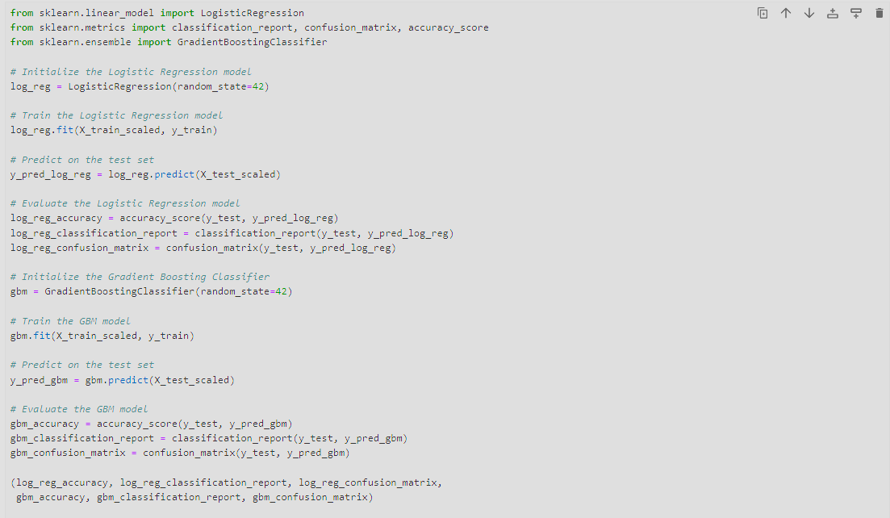
Source code

Slide 11
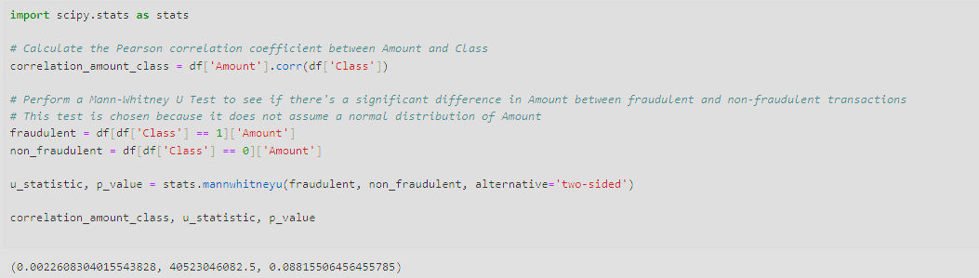
Source code (contd.)

Slide 12
Results
Logistic Regression Model
Accuracy: Approximately 96.50%
Classification Report:
Precision (Non-Fraudulent): 95%, (Fraudulent): 98%
Recall (Non-Fraudulent): 98%, (Fraudulent): 95%
The F1-score, which balances precision and recall, is approximately 96% for both classes.
Gradient Boosting Classifier
Accuracy: Approximately 97.93%
Classification Report:
Precision (Non-Fraudulent): 97%, (Fraudulent): 99%
Recall (Non-Fraudulent): 99%, (Fraudulent): 97%
The F1-score is approximately 98% for both classes, indicating a very balanced performance.

Slide 13
Results
Pearson Correlation Coefficient
The Pearson correlation coefficient between the amount and class is 0.0023
As the coefficient is close to 0, it suggests that there is almost no linear correlation between transaction amount and fraudulence.
Mann Whitney U test
The U statistic is approximately 40,523,046,082.5
The P value is approximately 0.088
With the obtained P value of 0.088, it suggests that we cannot conclude that there is a significant difference in transaction amounts between fraudulent and non-fraudulent transactions.

Slide 14
Conclusion
According to this analysis, there was little association between the transaction quantities and the likelihood of fraud in the smaller groups of data. On the other hand, the thorough examination of the sizable dataset revealed more distinct patterns, indicating the significance of both the number and quality of the data in the reliable predictive models. Consequently, both the gradient boosting machine approach and logistic regression method can achieve high recall rates, accuracy, and precision in fraud detection.

